Slide 1
Space Journey
By Ashlyn Hanson

Slide 2
Outline
Project Goal
Demo
Challenges
Algorithms
Discussion

Slide 3
Project Goal
Create a game where a UFO moves around space avoiding other space obstacles while trying to reach a specific target.

Slide 4
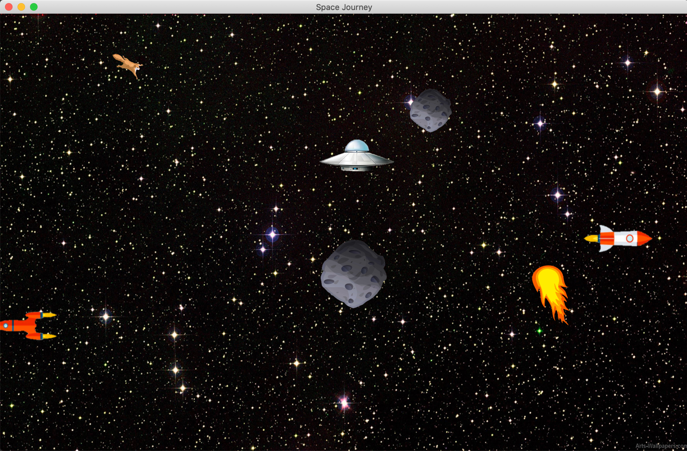
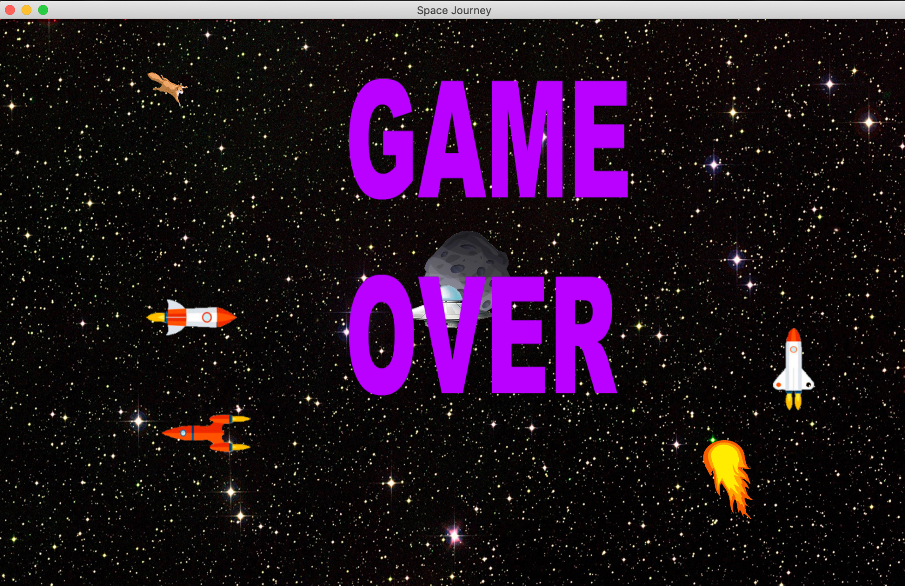
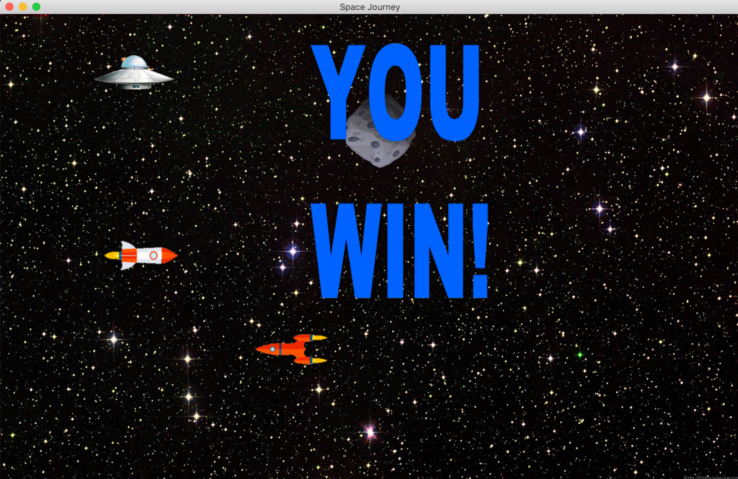
Demo

Slide 5
Challenges
Animations
Collision Detection
Game Screens

Slide 6
Algorithms
Collision Detection
Check is point is inside rectangle
Animation
Update vertex by disposition until reaches end of screen, then reset

Slide 7
Discussion
Future Improvements
Next Levels
More advanced animations
Questions?

